Slide 1
Sprint 1 Demo
Tuesday, May 3rd, 2022

Slide 2
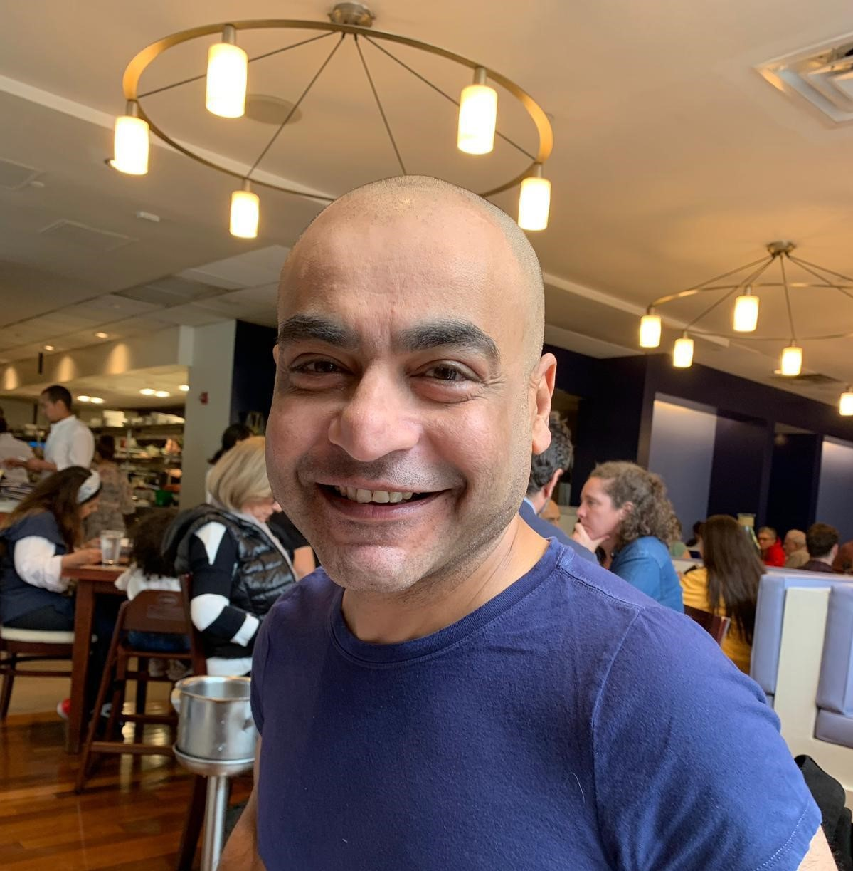

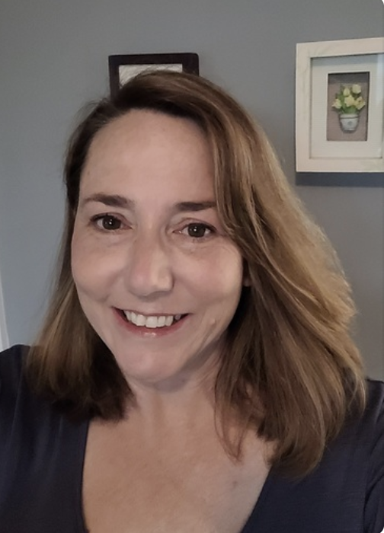
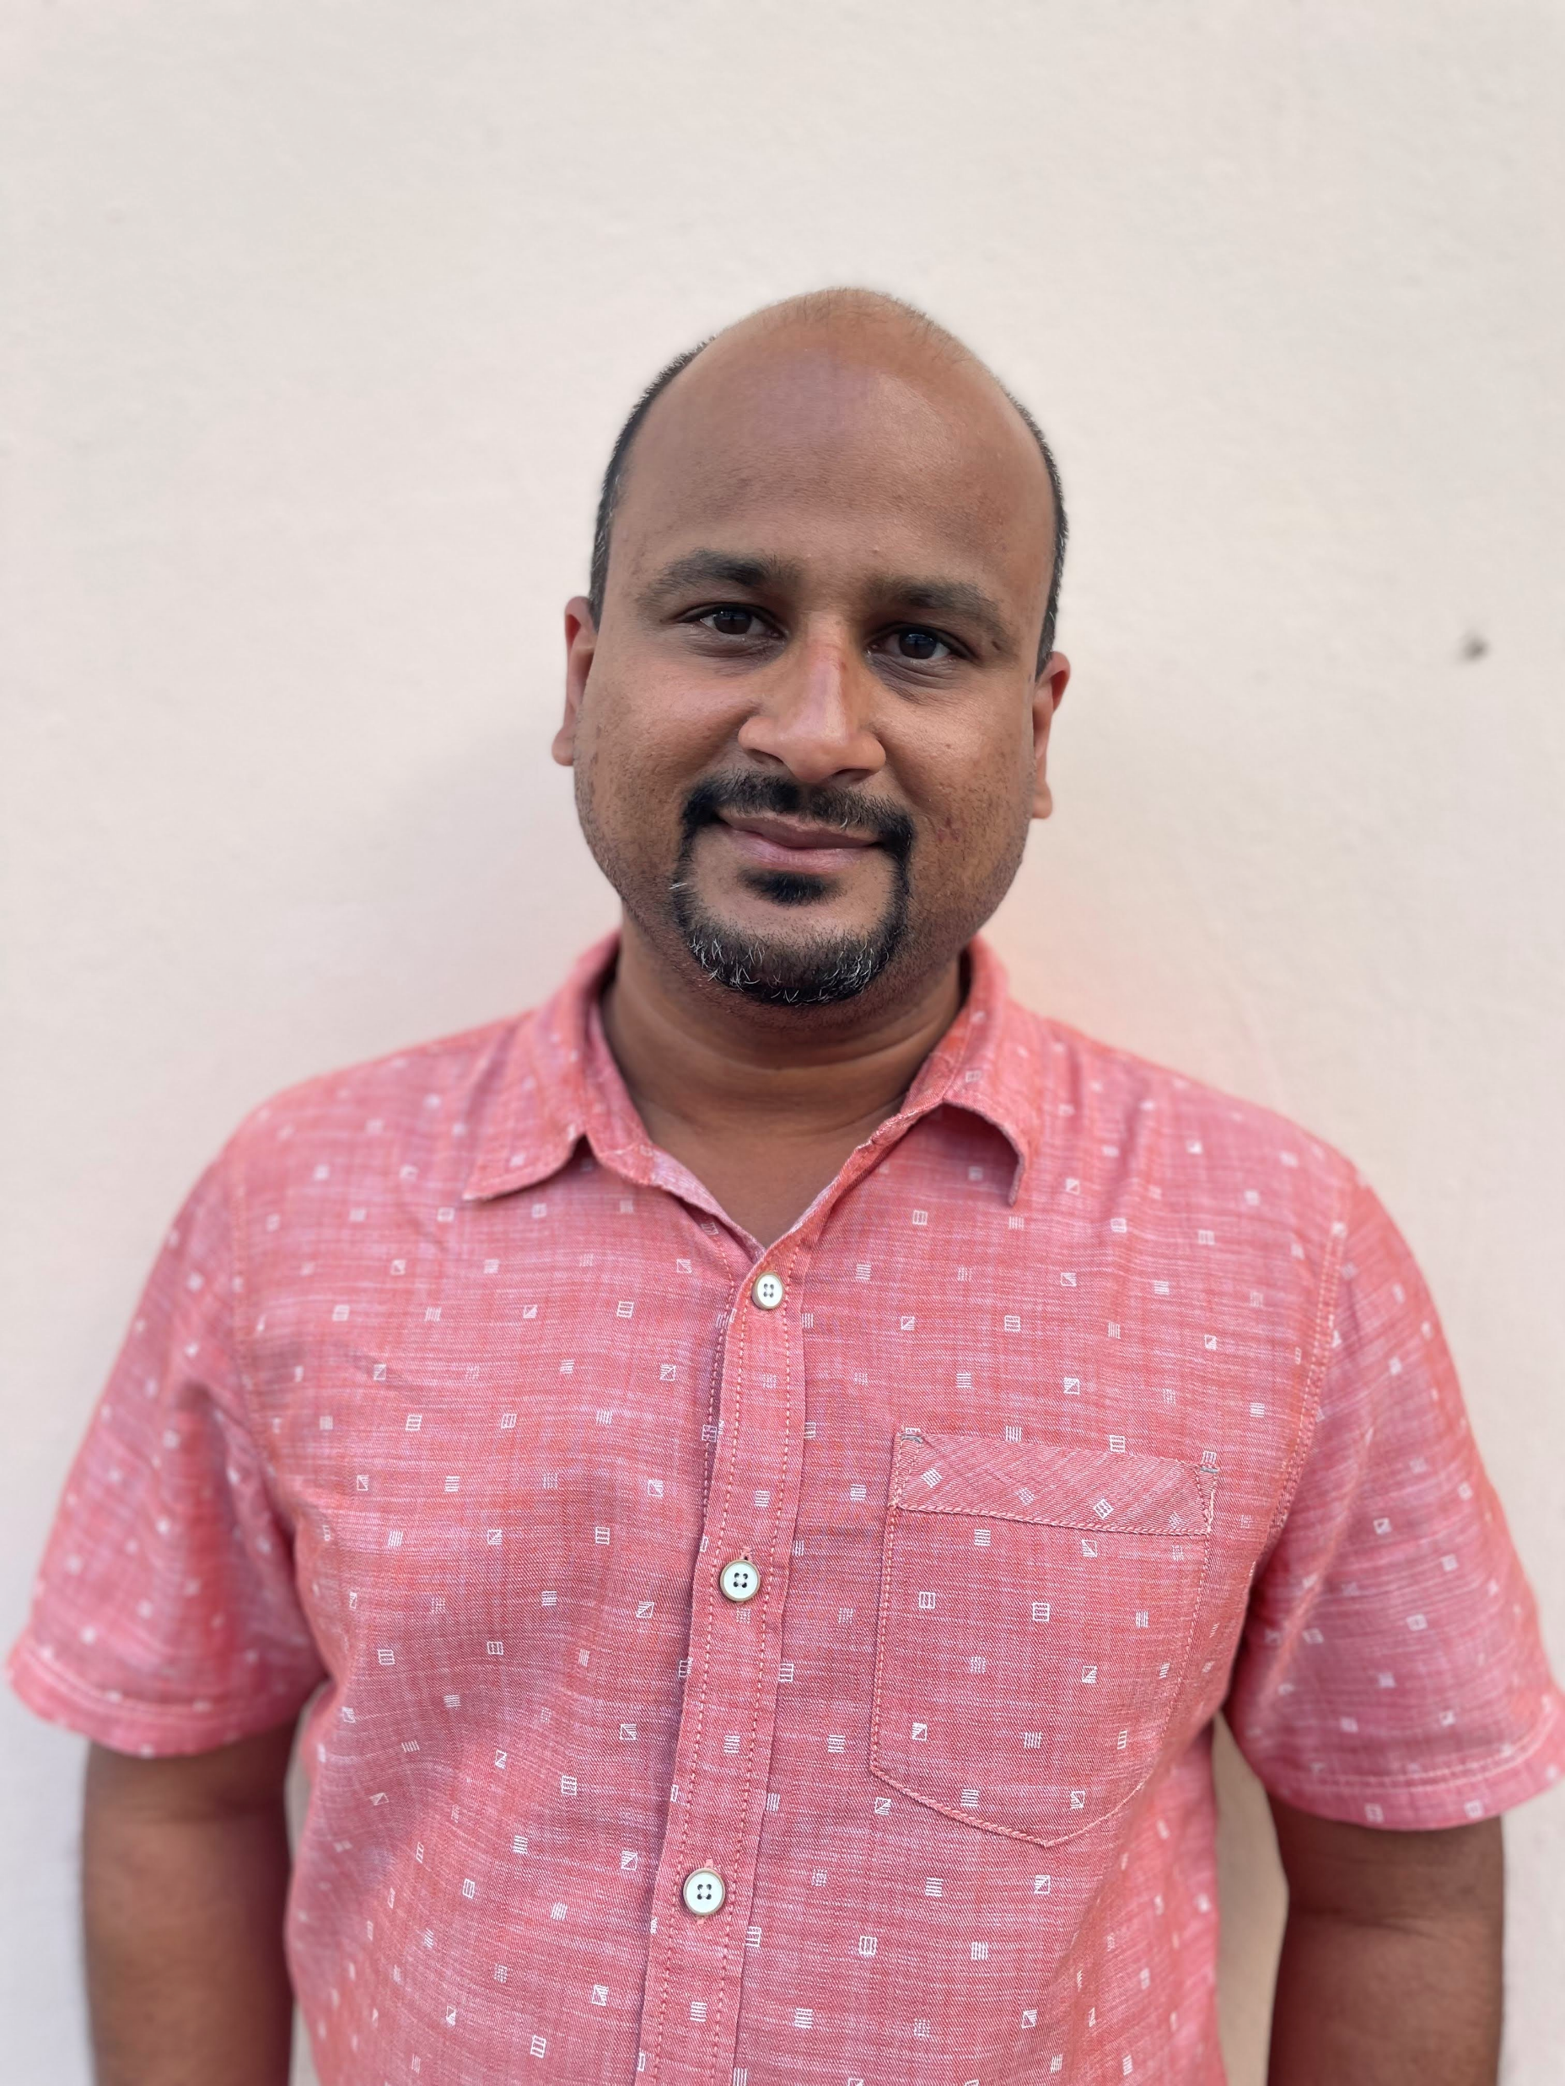









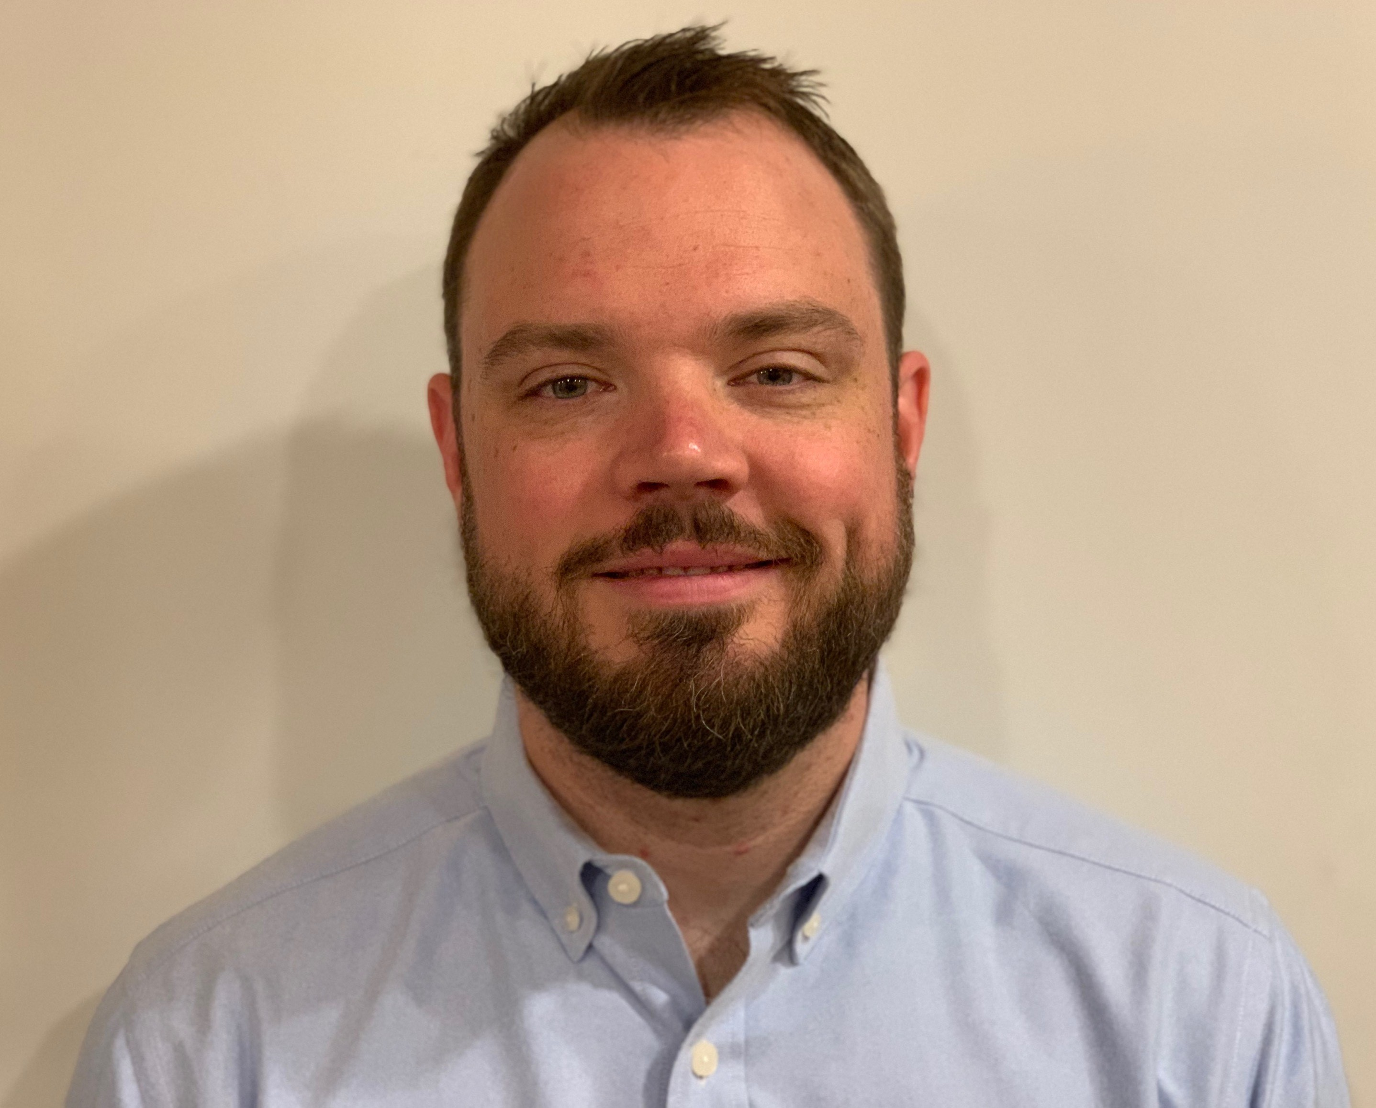
Get to know the team
Departures:
4/29 Teagan (will remain available for 1095-B work)
Core team
Executive team
PRODUCT
ENGINEERING
Munish Sikka
Washington DC
Product Lead
Jordan White Dallas, TX Product Manager
Tami Corson
North Carolina
Clinical SME / Scrum
Shashank Khandelwal
Rockville, MD
Tech Lead
Jeff Scheire
MO Studio
Marcy Jacobs
McKinsey & Co
Kevin London Frog Design
DESIGN
Thomas McCue Oak Park, IL Principal Designer Director
Carl Dickerson Atlanta, GA Content Strategist and Plain Language Content Creator
Carolyn Williams Chicago, IL Experience Designer
Teagan Stephenson Ft. Lauderdale, FL Full Stack Engineer
1095-B Product Only
Will Reynolds SERVE Advisory
Ben Morris
Pluribus Digital
Travis Hoffmann
MO Studio
05-03 Sprint 1 Demo
Introduction

Slide 3



At the end of each sprint on Tuesdays, the team will run sprint reviews to showcase the sprint’s work for approval. The purpose of this meeting is:
WELCOME TO THE SPRINT 1 DEMO
1
To demo the accomplishments or functionality that was built over the past sprint
2
To get feedback and insights early and often
3
To create transparency for anyone interested on the product and progress
05-03 Sprint 1 Demo
Introduction

Slide 4
CEDAR TO1 Overview
WE ARE HERE
PHASE
CY 2021
CY 2022
SPRINT
0
1
2
3
4
5
6
7
8
9
10
11
12
13
14
15
16
17
18
19
20
21
22
23
24
25
26
27
MONTH
Sep
Oct
Nov
Dec
Jan
Feb
Mar
Apr
May
Jun
Jul
Aug
Sep
DHM - Health Apartment
FOCUS
1095-B Form
Follow ups as needed
Community Care
Health Hub
05-03 Sprint 1 Demo
Introduction

Slide 5
Agenda
Sprint Goal: For sprint 1 we focused on understanding the product goals, discovery into current state, and development of initial project plan.
HEALTH HUB
Product draft strategic plan & vision
Business partner discovery
Revised problem statement
Existing research and gaps
Comparative research
1095-B
Updates on 1095-B
 | We welcome all feedback! Feedback will be collectively reviewed and prioritized appropriately based on where it stacks against other stories in the backlog as well as technical feasibility.
05-03 Sprint 1 Demo
Agenda

Slide 6
Health Hub
SPRINT 1 DEMO
05-03 Sprint 1 Demo

Slide 7
Health Hub Strategic Roadmap v1
WE ARE HERE
YEAR
CY 2022
Option YR
MONTH
Apr
May
Jun
Jul
Aug
Sep
SPRINT
Task Order
16
17
18
19
20
21
22
23
24
25
Product
1
2
3
4
5
6
7
8
9
10
FOCUS
Product Strategy
& Planning
Comparative
Research
Design Research
Design
Existing Research Consolidation
Tech Feasibility
Current
IA Map
Recommendations
Future
IA Map
05-03 Sprint 1 Demo
Product Management

Slide 8



Health Hub Workplan v1
Owned by design team
Owned by product/ engineering team
Release
WE ARE HERE
SPRINT 1
SPRINT 2
SPRINT 3
SPRINT 4
SPRINT 5
Week 1: 04/20 – 04/26
Week 2:
04-27 – 05/03
Week 3: 05/04 – 05/10
Week 4: 05/11 – 05/17
Week 5: 05/18 – 05/24
Week 6:
05/25 – 05/31
Week 7: 06/01-06/07
Week 8: 06/08-06/14
Week 9:
06/15-06/21
Week 10: 06/22-06/28
Product & Delivery
Build understanding of product and product goals
Build Roadmap
Build initial workplan and backlog
Kickoff
User Experience & Design
Comparative research
Business partner discovery
Build initial research plan
Conduct research
Consolidate existing research
Current state mapping
Engineering & Development
Tech Discovery
Tech Feasibility
05-03 Sprint 1 Demo
Workplan

Slide 9
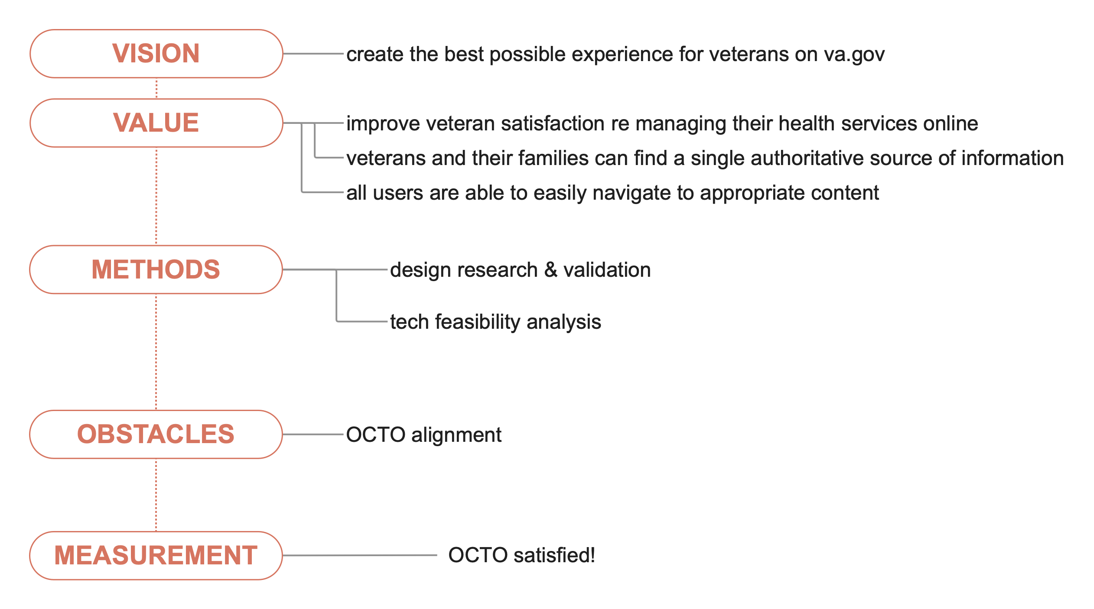
Project Vision & Goals
A
Other measurements to consider:
Veteran satisfaction and desire
Measurements for the recommendations post-implementation
05-03 Sprint 1 Demo
Overview

Slide 10

B
We started conversations with experts currently building health content on VA.gov
User Story: Conduct business partner discovery
Business partners we've spoken with:
Danielle Thierry
Meg Peters
Mikki Northuis
Tracey Mulrooney
Business partners we're planning to speak with:
Mikki Northuis (follow up)
Dave Conlon
Samara Strauss
Lauren Alexanderson
Beth Potts
Jeff Barnes
Link
05-03 Sprint 1 Demo
Health Hub
10

Slide 11
C
We aligned on product by reformulating problem statements into words that convey actionable items for our team
User Story: Further develop problem statements to include our understanding of problem
Problem Statements:
1. How might we best serve Veterans who don’t have healthcare learn about the benefits and apply for them?
2. How might we create the best personalized experiences for Veterans with healthcare who want to manage their care online?
3. How might we ensure all Veterans can learn about their benefits and get help at any point?
Link
05-03 Sprint 1 Demo
Health Hub
11

Slide 12
D
We consolidated and evaluated current research on products within the health space
User Story: Discover and consolidate current state research
User Story: Determine gaps in available research
Existing
Content Strategy for Veteran benefit experience
Product brief for Health Apartment
Health care hub evolution
Model for auth and unauth
Manage-only APT sitemap
Personalization 2.0 discovery
Veteran journey map
1010-ez Application research
Resources pilot (in progress)
Relevant gaps to explore
The transition of learning to managing health tasks
The cycle of manage to learn to manage
How a Veteran learns about their health benefits
Link
05-03 Sprint 1 Demo
Design
12

Slide 13
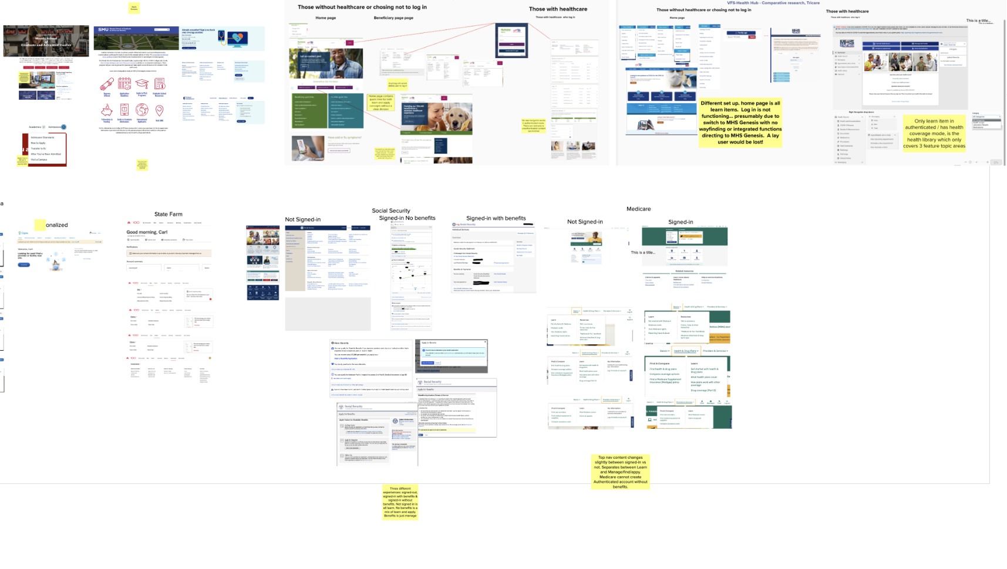
E
We conducted a comparative analysis of industry standards
User Story: Conduct comparative research of similar industries or institutions
Summary:
We analyzed experiences analogous to va.gov to discover potentially useful patterns, precedent, and best practices as related to content strategy that supports or guides users through application for and management of benefits.
Key Findings:
The veteran experience is unique, with few/no direct analogs
A fragmented landscape has few emergent patterns
Common strategies include uncategorized and distributed content, context relevant content, and consolidated knowledge base
User need for learning, guidance, or support content in an ongoing basis (versus just initial engagment) is unclear
Conclusion
The content strategy and IA landscape is marked by lack of clear best practices or useful patterns
"Learn, Apply, & Manage" may be a useful way to organize content
More research is needed to understand more about the what and when of content need across the Health benefit engagement
Link to Mural
05-03 Sprint 1 Demo
Health Hub
13

Slide 14
1095-B Status Update
SPRINT 1 DEMO
05-03 Sprint 1 Demo

Slide 15

1095-B Workplan
Owned by design team
Owned by product/ engineering team
Release
WE ARE HERE
SPRINT 7
SPRINT 8
SPRINT 9
SPRINT 10
SPRINT 11
Week 14: 04/20 – 04/26
Week 15:
04-27 – 05/03
Week 16: 05/04 – 05/10
Week 17: 05/11 – 05/17
Week 18: 05/18 – 05/24
Week 19:
05/25 – 05/31
Week 20: 06/01-06/07
Week 21: 06/08-06/14
Week 22:
06/15-06/21
Week 23: 06/22-06/28
Product & Delivery
1095-B: Identify Change Management or Communications Plan
1095-B: Legal Review
1095-B: Handover plan - Prepare for launch
1095-B: Spanish translation docs
1095-B: Opt-in follow up
User Experience & Design
1095-B wayfinding
Design for opt-in
Engineering & Development
1095-B wayfinding
Collaboration Cycle
1095-B Launch
1095-B Post launch evaluation
05-03 Sprint 1 Demo
Workplan

Slide 16
We continued to monitor 1095-B developments leading to launch and post-MVP build
1
PRODUCT
User Story: PM team to f/u on VA 508 accessibility ticket
User Story: PM team to f/u on VA profile ticket for opt-in
User Story: PM team to f/u on HEC legal review
User Story: PM team to f/u on documents for Spanish translation
User Story: Collaboration cycle: Staging review
User Story: 1095-B Team staging review accessibility checklist
User Story: Collaboration cycle: Analytics implementation
Updates on launch and opt-in blockers:
Still awaiting full legal approval from OGC (4.29.22)
VA Profile ticket with Nazmul Alam and he has not been free to update ticket to push forward (4.28.22)
VA 508 office has passed ticket to Mr. Sheehan for guidance (4.26.22)
Awaiting Spanish translation (4.29.22)
508 Ticket , VA Profile opt-in ticket, 1095-B updates 5.3.22
05-03 Sprint 1 Demo
1095-B
16

Slide 17
Blockers for 1095-B launch
BLOCKER | OWNED BY | ACTION NEEDED | DATE ENTERED | STATUS | NOTES
Legal review | Tarsha Tremble (Business Owner) | Business Owner is seeking a POC with the Office of General Counsel to understand requirements for legal review and timeline | Sprint 3 - 3/2/22 |  | Team is awaiting further word on legal review after follow up from Chris Johnson
PDF Accessibility | Tarsha Tremble (Business Owner) | Team received PDF from IRS, but PDF is still not accessible once it is populated with data | Sprint 3 – 3/3/22 |  | Team is awaiting further word from 508 office
05-03 Sprint 1 Demo
1095-B Blockers

Slide 18
1095-B Remaining actions, with external dependencies
ITEM | WORK STREAM | ACTION NEEDED | TARGET COMPLETE DATE | PREREQUISITE
Tech refinements & testing | Tech | Update backend and react widget as needed based on staging review and UAT feedback Build out and conduct testing | TBD | Product dark launched
UAT | Product & Tech | Follow Collaboration Cycle guidelines for UAT Identify Veterans within VA to conduct UAT, send access, and follow up to ensure testing complete | TBD | Product dark launched
1095-B Opt-in | Product | Follow up with HEC and Profiles team to ensure opt-in is done Update draft communications and announcement plans, based on when opt-in will be launched | April - May | HEC and Profiles commitment to building opt-in
Legal Review | Product | Work with Tarsha to complete legal review | March – May | POC name from Tarsha
Post Launch Check- In | Product | Complete Collaboration Cycle milestone to KPIs post launch | TBD (One month after launch and announcement) | Product launched in prod
Links from VA.gov pages to 1095-B | Product & Design | Work with IA team to have other identified pages within VA.gov (e.g., ACA page) link to the 1095-B page Work with IA team to have 1095-B page added to navigation and be found in VA.gov search | May or later | Product launched in prod; aligned on comm plan with Tarsha, Tracey
1095-B update strategy | Product | Align on who will own 1095-B long term, including updating the PDF template each year | May or later | Product complete and launched in production
Communications to announce launch | Product & Design | Work with Tarsha and HEC team to refine drafted communications and align on plan and timeline to announce 1095-B launch to Veterans Work with VA Notify team to build and launch communications on their platform | October - December | Product launched in prod; aligned on communication plan with Tarsha/Tracey
05-03 Sprint 1 Demo
1095-B Remaining actions

Slide 19
Sprint Deliverables
SPRINT 1 DEMO
05-03 Sprint 1 Demo

Slide 20
Sprint 1 Deliverables – Health Hub
EPIC | STORY | ESTIMATE | ASSIGNED | OUTPUT | REVIEWED W/ VA-PO | SPRINT TEAM GOAL COMPLETED?
Tech | #40433 Further develop problem statements to include our understanding of problem | 5 | Shashank | Revised statements User personas | 5/3/22 | ✓
Tech | #39922 Platform orientation [Shashank Khandelwal] | 5 | Shashank | Ticket | 5/3/22 | ✓
Design | #40427 Discover and consolidate current state research | 8 | Carl | Research discovery | 5/2/22 | ✓
Design | #40432 Conduct business partner discovery | 5 | Carolyn | Initial discovery notes 4/25 Mtg w/ Meg 4/29 Mtg w/ Danielle 4/29 | 4/29/22 | ✓
Design | #40429 Conduct comparative research of similar industries or institutions | 13 | Thomas Carolyn | Mural | 4/29/22 | ✓
Design | #40008 Platform orientation [Carolyn Williams] | 5 | Carolyn | Ticket | 5/3/22 | ✓
Design | #40009 Platform orientation [Thomas McCue] | 5 | Thomas | Ticket | 5/3/22 | ✓
PM | #40431 Determine gaps in available research | 5 | Jordan | NR | 5/5/22 | ✓
PM | #40442 Create business partner communication / discovery plan | 1 | Tami | HH Comm Log | 4/21/22 | ✓
PM | #40441 Create team cadence with key VA personnel | 1 | Tami | Cadence | 4/20/22 | ✓
Product | #40754 Develop initial strategic roadmap & vision | 5 | Munish | Demo slide 7 - 9 | 5/2/22 | ✓
05-03 Sprint 1 Demo
Sprint 6 Deliverables

Slide 21
Sprint 1 Deliverables – 1095-B
EPIC | STORY | ESTIMATE | ASSIGNED | OUTPUT | REVIEWED W/ VA-PO | SPRINT TEAM GOAL COMPLETED?
Product | #40455 PM team to f/u on HEC legal review | 0 | Tami | 1095-B Updates | 5/3/22 | ✓
Product | #40454 PM to f/u w/ VA-PO on HEC documents being translated into Spanish | 0 | Tami | 1095-B Updates | 5/3/22 | ✓
Product | #39723 PM team to f/u on VA Notify ticket for opt-in | 1 | Tami | #CMDMRP-2269 1095-B Updates | 5/3/22 | ✓
Product | #39722 PM to f/u on VA 508 accessibility support ticket | 1 | Tami | YourIT # RITM6608047 1095-B Updates | 5/3/22 | ✓
Product | #38351 Collaboration cycle: Staging review [1095-B] | 0 | Jordan | Ticket | 5/3/22 | ✓
Tech | #36175 Collaboration cycle: Analytics implementation [1095-B] | 0 | Teagan Shashank | Ticket | 5/3/22 | ✓
Tech | #38387 1095-B Team staging review accessibility checklist | 0 | Teagan Shashank | Ticket | 5/3/22 | ✓
05-03 Sprint 1 Demo
Sprint 6 Deliverables

Slide 22
Preview of Sprint 2
SPRINT 1 DEMO
05-03 Sprint 1 Demo

Slide 23
Sprint 2 of Health Hub will focus on
 | Next sprint demo: May 17th
HEALTH HUB
*Stories subject to change during Sprint planning
Refine product roadmap and workplan
Continue business partner discovery
Align on research approach
Draft current state of Health Hub IA
1095-B
Updates on 1095-B
05-03 Sprint 1 Demo
Preview of Sprint 2 – Health Hub

Slide 24
Appendix
SPRINT 1 DEMO

Slide 25
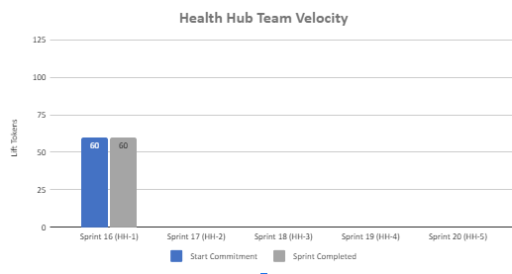
Health Hub Team velocity
 | Velocity details Velocity estimated in story points, using Fibonacci Velocity in Sprint 1 accounted for 8 team members 60 total story points were completed; Team committed to 60 story points at beginning of the sprint. 7 Stories represent 1095-B work (2 points) and remain blocked / stalled related to HEC legal review, Spanish translation, Opt-in function request, and VA 508 office assistance request
05-03 Sprint 1 Demo
Appendix
25

Slide 26
Project risks and mitigation strategies
Munish & Jordan to update with content that includes Health Hub risks.
Submitted as part of the Monthly Report for March
RISK AND IMPACT | MITIGATION STRATEGY | DATE |  | STATUS | NOTES
 |  | ENTERED | CLOSED
IRS stakeholder is outside of VA ecosystem. Building without guidance or legal review regarding compliance with IRS regulation could result in risk. | Conduct research on available information surrounding current IRS 1095-B tax form regulations. Seek legal review through VA resources as directed by VA-PO and Business Owner | 1/20/22 | 2/11/22 |  | VA Business Owner clarified that IRS review is not needed
Team had previously confirmed with Business Owner that legal review was not needed. Business Owner clarified that legal review would be needed as of March 2nd | Business Owner is seeking a POC with the Office of General Counsel to understand what is needed and potential launch impact | 3/2/22 |  |  | Launch blocker
Data requires storage in a S3 bucket that the enrollment system can have access to in production; process to create the staging and production bucket does not have a clear timeline. Without the S3 bucket in prod with enrollment system access, product cannot be built in prod | Daily follow-ups with Jesse House and Mike Chelan (infrastructure team) | 3/1/22 | 3/24/22 |  | S3 bucket now in place. Risk resolved.
Business owner raised User Acceptance Testing should be done with HEC Call Center | Requested Business Owner to schedule UAT with required individuals for mid-March and book as early as possible | 3/2/22 | 3/25/22 |  | Business owner confirmed that UAT can be done through Collaboration Cycle and does not have to be done with HEC team
Feedback from Content and IA Review has taken over a week to come in; feedback is changing our proposal for the H1 and delaying confirmation of where the 1095-B landing page should live, which in turn delays our ability to complete the front end (top nav and side nav bars) | Design team pushing on IA team to confirm final answer of where 1095-B landing page should live and what the H1 header title should be | 03/04/22 | 3/8/22 |  | URL confirmed 3/7 EOD; IA review now closed
Designs were approved as part of Midpoint Review. Afterwards, Sitewide Content stated they would need to build our front end in Drupal and change our designs, impacting our in-flight build. | Design team met with Sitewide Content to align on redesigned front end. Tech working with Sitewide Content to send over our dynamic widget to be pulled into their static front end. Sitewide Content now owns the front end build. | 3/10/22 |  |  | Launch date dependent on Sitewide Content ability to launch front end

Slide 28
1
TECH
Lorem
User Story: Lorem
User Story: Lorem
User Story: Lorem
User Story: Lorem
User Story: Lorem
Lorem
Lorem
Lorem
Lorem
Lorem
Lorem
Lorem
Link
05-03 Sprint 1 Demo
Tech
28

Slide 29
2
DESIGN
Lorem
User Story: Lorem
User Story: Lorem
Lorem
Lorem
Link
05-03 Sprint 1 Demo
Design
29

Slide 30
2
DESIGN
Lorem
User Story: Lorem
User Story: Lorem
Lorem
Lorem
Link
05-03 Sprint 1 Demo
Design
30

Slide 31
3
PRODUCT
Lorem
User Story: Lorem
User Story: Lorem
Lorem
Lorem
Link
05-03 Sprint 1 Demo
Product
31

Slide 32
1
TECH
Lorem
User Story: Lorem
User Story: Lorem
User Story: Lorem
User Story: Lorem
User Story: Lorem
Lorem
Lorem
Lorem
Lorem
Lorem
Lorem
Lorem
Link
05-03 Sprint 1 Demo
Tech
32

Slide 33
2
DESIGN
Lorem
User Story: Lorem
User Story: Lorem
Lorem
Lorem
Link
05-03 Sprint 1 Demo
Design
33

Slide 34
2
DESIGN
Lorem
User Story: Lorem
User Story: Lorem
Lorem
Lorem
Link
05-03 Sprint 1 Demo
Design
34

Slide 35
3
PRODUCT
Lorem
User Story: Lorem
User Story: Lorem
Lorem
Lorem
Link
05-03 Sprint 1 Demo
Product
35

Slide 36
Sprint 1 will run April 20 to May 3rd
Owned by design team
Owned by product/ engineering team
Release
WE ARE HERE
SPRINT 1
SPRINT 2
SPRINT 3
SPRINT 4
SPRINT 5
Week 1: 04/20 – 04/26
Week 2: 04/27 – 05/03
Week 3: 05/04 – 05/10
Week 4: 05/11- 05/17
Week 5: 05/18 – 05/24
Week 6: 05/25 – 05/31
Week 7: 06/01 – 06/07
Week 8:
06/08 – 06/14
Week 9: 06/15-06/21
Week 10: 06/22-06/28
Product & Delivery
1095-B: Identify Change Management or Communications Plan
1095-B: Legal Review
1095-B: Handover plan - Prepare for launch
1095-B: Opt-in follow up
1095-B: Spanish translation docs
HH: Charter
HH: Develop backlog + Vision Framework
HH: Roadmap
User Experience & Design
1095-B: Wayfinding plan
Testing prep & recruiting
Voice of Veteran
Voice of Veteran
HH: Discovery
HH: Stakeholder Interviews
HH: Current State Journey Map
Prioritized plan
Engineering & Development
HH: Tech discovery
HH: Stakeholder Interviews
HH: Proposed tech integrations based off research findings
Collaboration Cycle
Midpoint Review
1095-B: Launch Date Dependent on Legal Review Completion
Research Plan Review
Research Plan Review
*Does not show post-MVP Validate phase meetings in Collaboration Cycle, such as Full Accessibility Audit and Post-Launch Check In; Contact Center Review adjusted to 3 weeks before launch as approved by Jason Woodman
Preview of Sprint 7

